Slide 1
MANAGEMENT OF INTESTINAL OBSTRUCTION
SUMUDU KUMARAGE
SENIOR LECTURER IN SURGERY

Slide 2
DEFINITION
CLASSIFICATION
CAUSES
HISTORY
EXAMINATION
INVESTIGATION
MANAGEMENT
INDICATIONS FOR SURGERY

Slide 3
Blockage of bowel that prevents the contents of the intestine from passing through.
Complete
Incomplete
Types
Paralytic ileus
Mechanical

Slide 4
Paralytic Ileus
Post operative
Inflammatory-peritonitis
Metabolic- hypokalaemia;uremia

Slide 5
Mechanical obstruction
Extramural – adhesions; hernia ; volvulus ; neoplasm
Intramural – neoplasm ; stricture ; Intussuception
Intraluminal - gallstones ; faecal impaction; FB

Slide 6
Pathophysiology
Bowel distal to the obstruction – collapse
Bowel proximal to obstruction – distended ; hyperactive
Bowel wall becomes oedematous
Fluid and electrolytes accumulate in the lumen
Bacterial proliferation
Intramural vessels are stretched – ischemia and necrosis ; perforation

Slide 7
Signs and symptoms
Abdo pain
Vomiting
Distension
Constipation
High pitched bowel sounds
Empty rectum
These clinical features vary depend on the site of obstruction

Slide 8
Other clinical features
Features of dehydration
hypotension
Tachycardia
These features depend on the severity of obstruction

Slide 9
Features to suggest complications
Tachycardia
Tenderness
Rebound tenderness
Signs of acute abdomen

Slide 10
Pain
Peri umbilical colicky ;comes in waves at interval of 2- 3 mts – small bowel
Suprapubic dull continuous – large bowel
Severe continuous - ?strangulation

Slide 11
vomiting
Higher the obstruction –severe
Bile – proximal
Feculent - distal

Slide 12
Distension
More distal the obstruction more distension of the abdomen
Visible peristalsis may present

Slide 13
constipation
May pass stools or flatus at the early stage
Occurs early in lower large bowel obstruction
Absolute constipation is a feature of complete obstruction

Slide 14
High small bowel obstruction
Severe vomiting –bile+
Early dehydration
Minimum distension
Colicky pain
Lower large bowel obstruction
More distension
Mild dull pain
Late vomiting
Late dehydration

Slide 15
Examination
Hydration
Fever
Pallor
Tachycardia;hypotension
Abdo
Visible scars
Hernial orifices
Distension
Tenderness; RT;gurding;rigidity
Bowel sounds
DRE

Slide 16
Investigations
FBC
SE
BU S cr
ABG
Radiology
Abdo X ray – supine –give an idea of the site of obstruction
L.B - peripheral/haustration
SB – central
Jejunum-valvulae coniventes
Ileum –feature less
Erect – fluid levels – presence of obstruction

Slide 17
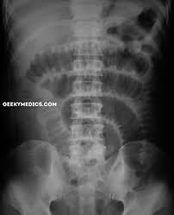

Slide 18
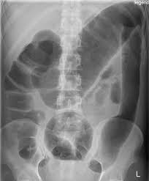

Slide 19
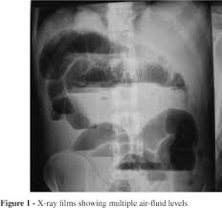

Slide 20
CECT abdo
Level
Complete or incomplete
Cause – Tu;hernia
Signs of strangulation
Ischemia
perforation

Slide 21
Pseudo obstruction/ paralytic ileus
No mechanical cause
Exclusion of a mechanical cause
Causes
Idiopathic
Metabolic
Inflammatory
Retroperitoneal irritation
Drugs
Bowel handling

Slide 22
Principals of management
Decompression – NG drainage
Fluid/electrolyte replacement
Pain relief
Relive obstruction
WFW
Surgery
Nutritional support
Monitoring
BP;pulse;temp;input/output;CVP

Slide 23
Indication for surgery
Evidence of strangulation/perforation/peritonitis
Cause of obstruction is unlikely to be resolved spontaneously
No resolution of obstruction with conservative management in 48-72 hrs

